Slide 1
TAI: Série d’exercices 3
N. Mebtouche novembre2023

Slide 2
Exo 1:
Exemple:
1 |  | 0
-1 | -1 | -1
0 | 0 | 0
1 | 1 | 1
-1 | -1 | -1
0 | 0 | 0
1 | 1 | 1
-1 | -1 | -1
0 | 0 | 0
1 | 1 | 1
1 | 1 | 1
0 | 0 | 0
-1 | -1 | -1
1
1 | 1
1 | 1 | 1
1 | 1 | 1
3
1 | 1 | 1
3 | 1
1 | 1 | 1
3 | 1 | -1
1 | 1 | 1
3 | 1 | -1
0
1 | 1 | 1
3 | 1 | -1
0 | 0
-1 | -1 | -1
0 | 0 | 0
1 | 1 | 1
1 | 1 | 1
3 | 1 | -1
0 | 0 | 0
-1 | -1 | -1
0 | 0 | 0
1 | 1 | 1
-1 | -1 | -1
0 | 0 | 0
1 | 1 | 1
-1 | -1 | -1
0 | 0 | 0
1 | 1 | 1
-1 | -1 | -1
0 | 0 | 0
1 | 1 | 1
-1 | -1 | -1
0 | 0 | 0
1 | 1 | 1
Filtre
1 | 1 | 1
0 | 0 | 0
-1 | -1 | -1
Résultat
Image
Flip vertical
-1 | -1 | -1
0 | 0 | 0
1 | 1 | 1
On inverse le filtre dans le deux axes.
La convolution est plus petite que la taille originale de l’image.
Solution: Le padding!
Flip horizontal

Slide 3
Exo 1:
 | 1 |  | 0
 | 1 |  | 0
-1 | -1 | -1
0 | 0 | 0
1 | 1 | 1
-1 | -1 | -1
0 | 0 | 0
1 | 1 | 1
-1 | -1 | -1
0 | 0 | 0
1 | 1 | 1
-1 | -1 | -1
0 | 0 | 0
1 | 1 | 1
-1 | -1 | -1
0 | 0 | 0
1 | 1 | 1
0
0 | 0
0 | 0 | 1
0 | 0 | 1 | 2
0 | 0 | 1 | 2 | 2
0 | 0 | 1 | 2 | 2
0
0 | 0 | 1 | 2 | 2
0 | 0
0 | 0 | 1 | 2 | 2
0 | 0 | 1
0 | 0 | 1 | 2 | 2
0 | 0 | 1 | 1
0 | 0 | 1 | 2 | 2
0 | 0 | 1 | 1 | 0
0 | 0 | 1 | 2 | 2
0 | 0 | 1 | 1 | 0
2
0 | 0 | 1 | 2 | 2
0 | 0 | 1 | 1 | 0
2 | 3
0 | 0 | 1 | 2 | 2
0 | 0 | 1 | 1 | 0
2 | 3 | 1
0 | 0 | 1 | 2 | 2
0 | 0 | 1 | 1 | 0
2 | 3 | 1 | -1
0 | 0 | 1 | 2 | 2
0 | 0 | 1 | 1 | 0
2 | 3 | 1 | -1 | -2
0 | 0 | 1 | 2 | 2
0 | 0 | 1 | 1 | 0
2 | 3 | 1 | -1 | -2
0
0 | 0 | 1 | 2 | 2
0 | 0 | 1 | 1 | 0
2 | 3 | 1 | -1 | -2
0 | 0
0 | 0 | 1 | 2 | 2
0 | 0 | 1 | 1 | 0
2 | 3 | 1 | -1 | -2
0 | 0 | 0
0 | 0 | 1 | 2 | 2
0 | 0 | 1 | 1 | 0
2 | 3 | 1 | -1 | -2
0 | 0 | 0 | 0
0 | 0 | 1 | 2 | 2
0 | 0 | 1 | 1 | 0
2 | 3 | 1 | -1 | -2
0 | 0 | 0 | 0 | 0
0 | 0 | 1 | 2 | 2
0 | 0 | 1 | 1 | 0
2 | 3 | 1 | -1 | -2
0 | 0 | 0 | 0 | 0
-2
0 | 0 | 1 | 2 | 2
0 | 0 | 1 | 1 | 0
2 | 3 | 1 | -1 | -2
0 | 0 | 0 | 0 | 0
-2 | -3
0 | 0 | 1 | 2 | 2
0 | 0 | 1 | 1 | 0
2 | 3 | 1 | -1 | -2
0 | 0 | 0 | 0 | 0
-2 | -3 | -2
0 | 0 | 1 | 2 | 2
0 | 0 | 1 | 1 | 0
2 | 3 | 1 | -1 | -2
0 | 0 | 0 | 0 | 0
-2 | -3 | -2 | -1
1 |  | 0
0 | 0 | 1 | 2 | 2
0 | 0 | 1 | 1 | 0
2 | 3 | 1 | -1 | -2
0 | 0 | 0 | 0 | 0
-2 | -3 | -2 | -1 | 0
1 | 1 | 1
0 | 0 | 0
-1 | -1 | -1
-1 | -1 | -1
0 | 0 | 0
1 | 1 | 1
-1 | -1 | -1
0 | 0 | 0
1 | 1 | 1
-1 | -1 | -1
0 | 0 | 0
1 | 1 | 1
-1 | -1 | -1
0 | 0 | 0
1 | 1 | 1
-1 | -1 | -1
0 | 0 | 0
1 | 1 | 1
-1 | -1 | -1
0 | 0 | 0
1 | 1 | 1
-1 | -1 | -1
0 | 0 | 0
1 | 1 | 1
-1 | -1 | -1
0 | 0 | 0
1 | 1 | 1
-1 | -1 | -1
0 | 0 | 0
1 | 1 | 1
-1 | -1 | -1
0 | 0 | 0
1 | 1 | 1
-1 | -1 | -1
0 | 0 | 0
1 | 1 | 1
-1 | -1 | -1
0 | 0 | 0
1 | 1 | 1
-1 | -1 | -1
0 | 0 | 0
1 | 1 | 1
-1 | -1 | -1
0 | 0 | 0
1 | 1 | 1
Filtre
-1 | -1 | -1
0 | 0 | 0
1 | 1 | 1
1 | 1 | 1
0 | 0 | 0
-1 | -1 | -1
-1 | -1 | -1
0 | 0 | 0
1 | 1 | 1
-1 | -1 | -1
0 | 0 | 0
1 | 1 | 1
-1 | -1 | -1
0 | 0 | 0
1 | 1 | 1
-1 | -1 | -1
0 | 0 | 0
1 | 1 | 1
-1 | -1 | -1
0 | 0 | 0
1 | 1 | 1
Résultat
Flip vertical
-1 | -1 | -1
0 | 0 | 0
1 | 1 | 1
Image
La convolution à la même taille que l’image d’origine
Les informations aux bords de l’image sont préservées
Le padding: K/2
Flip horizontal

Slide 4
Exo 1:

Slide 5
Exo 1:
 |  | 1
 |  | 1
 |  | 1
 |  | 1
 |  | 1
 |  | 1
 |  | 1
 |  | 1
 |  | 1
 |  | 1
 |  | 1
 |  | 1
 |  | 1
 |  | 1
 |  | 1
 |  | 1
 |  | 1
 |  | 1
 |  | 1
 |  | 1
 |  | 1
 |  | 1
 |  | 1
 |  | 1
 |  | 1
 |  | 1
 |  | 1
 |  | 1
 |  | 1
 |  | 1
 |  | 1
0
0 | 0
0 | 0 | 0
0 | 0 | 0 | 0
0 | 0 | 0 | 0 | 0
0 | 0 | 0 | 0 | 0 | 0
0 | 0 | 0 | 0 | 0 | 0 | 0
0 | 0 | 0 | 0 | 0 | 0 | 0 | 0
0 | 0 | 0 | 0 | 0 | 0 | 0 | 0 | 0
0 | 0 | 0 | 0 | 0 | 0 | 0 | 0 | 0 | 0
0 | 0 | 0 | 0 | 0 | 0 | 0 | 0 | 0 | 0 | 0
0 | 0 | 0 | 0 | 0 | 0 | 0 | 0 | 0 | 0 | 0 | 0
0 | 0 | 0 | 0 | 0 | 0 | 0 | 0 | 0 | 0 | 0 | 0 | 0
0 | 0 | 0 | 0 | 0 | 0 | 0 | 0 | 0 | 0 | 0 | 0 | 0 | 0
0 | 0 | 0 | 0 | 0 | 0 | 0 | 0 | 0 | 0 | 0 | 0 | 0 | 0 | 0
0 | 0 | 0 | 0 | 0 | 0 | 0 | 0 | 0 | 0 | 0 | 0 | 0 | 0 | 0
0
0 | 0 | 0 | 0 | 0 | 0 | 0 | 0 | 0 | 0 | 0 | 0 | 0 | 0 | 0
0 | 0
0 | 0 | 0 | 0 | 0 | 0 | 0 | 0 | 0 | 0 | 0 | 0 | 0 | 0 | 0
0 | 0 | 0
0 | 0 | 0 | 0 | 0 | 0 | 0 | 0 | 0 | 0 | 0 | 0 | 0 | 0 | 0
0 | 0 | 0 | 0
0 | 0 | 0 | 0 | 0 | 0 | 0 | 0 | 0 | 0 | 0 | 0 | 0 | 0 | 0
0 | 0 | 0 | 0 | 0
0 | 0 | 0 | 0 | 0 | 0 | 0 | 0 | 0 | 0 | 0 | 0 | 0 | 0 | 0
0 | 0 | 0 | 0 | 0 | 0
0 | 0 | 0 | 0 | 0 | 0 | 0 | 0 | 0 | 0 | 0 | 0 | 0 | 0 | 0
0 | 0 | 0 | 0 | 0 | 0 | 0
0 | 0 | 0 | 0 | 0 | 0 | 0 | 0 | 0 | 0 | 0 | 0 | 0 | 0 | 0
0 | 0 | 0 | 0 | 0 | 0 | 0 | 0
0 | 0 | 0 | 0 | 0 | 0 | 0 | 0 | 0 | 0 | 0 | 0 | 0 | 0 | 0
0 | 0 | 0 | 0 | 0 | 0 | 0 | 0 | 0
0 | 0 | 0 | 0 | 0 | 0 | 0 | 0 | 0 | 0 | 0 | 0 | 0 | 0 | 0
0 | 0 | 0 | 0 | 0 | 0 | 0 | 0 | 0 | 0
0 | 0 | 0 | 0 | 0 | 0 | 0 | 0 | 0 | 0 | 0 | 0 | 0 | 0 | 0
0 | 0 | 0 | 0 | 0 | 0 | 0 | 0 | 0 | 0 | 0
0 | 0 | 0 | 0 | 0 | 0 | 0 | 0 | 0 | 0 | 0 | 0 | 0 | 0 | 0
0 | 0 | 0 | 0 | 0 | 0 | 0 | 0 | 0 | 0 | 0 | 1
0 | 0 | 0 | 0 | 0 | 0 | 0 | 0 | 0 | 0 | 0 | 0 | 0 | 0 | 0
0 | 0 | 0 | 0 | 0 | 0 | 0 | 0 | 0 | 0 | 0 | 1 | 1
0 | 0 | 0 | 0 | 0 | 0 | 0 | 0 | 0 | 0 | 0 | 0 | 0 | 0 | 0
0 | 0 | 0 | 0 | 0 | 0 | 0 | 0 | 0 | 0 | 0 | 1 | 1 | 1
0 | 0 | 0 | 0 | 0 | 0 | 0 | 0 | 0 | 0 | 0 | 0 | 0 | 0 | 0
 |  |  |  |  |  |  |  |  |  |  |  |  |  | 0
0 | 0 | 0 | 0 | 0 | 0 | 0 | 0 | 0 | 0 | 0 | 0 | 0 | 0 | 0
0 | 0 | 0 | 0 | 0 | 0 | 0 | 0 | 0 | 0 | 0 | 1 | 1 | 1 | 0
0 | 0 | 1 | 1 | 0 | 0 | 0 | 0 | 0 | 0 | 0 | 1 | 1 | 1 | 0
0 | 1 | 1 | 1 | 0 | 0 | 0 | 0 | 0 | 0 | 0 | 1 | 1 | 1 | 0
0 | 1 | 1 | 1 | 0 | 0 | 0 | 0 | 0 | 1 | 0 | 0 | 0 | 0 | 0
0 | 1 | 1 | 1 | 0 | 0 | 0 | 0 | 0 | 0 | 0 | 0 | 0 | 0 | 0
0 | 0 | 0 | 0 | 1 | 1 | 0 | 0 | 0 | 0 | 0 | 1 | 1 | 1 | 0
0 | 0 | 1 | 0 | 1 | 1 | 0 | 0 | 0 | 0 | 0 | 1 | 1 | 1 | 0
0 | 0 | 1 | 1 | 1 | 1 | 0 | 0 | 0 | 0 | 0 | 1 | 1 | 1 | 0
0 | 0 | 1 | 1 | 1 | 1 | 0 | 0 | 0 | 1 | 0 | 0 | 0 | 0 | 0
0 | 0 | 0 | 0 | 1 | 1 | 0 | 0 | 0 | 0 | 0 | 0 | 0 | 0 | 0
0 | 0 | 0 | 0 | 1 | 1 | 0 | 0 | 0 | 0 | 0 | 1 | 1 | 1 | 0
0 | 0 | 1 | 0 | 0 | 0 | 0 | 0 | 0 | 0 | 0 | 1 | 1 | 1 | 0
0 | 0 | 0 | 0 | 0 | 0 | 0 | 0 | 0 | 0 | 0 | 1 | 1 | 1 | 0
0 | 0 | 0 | 0 | 0 | 0 | 0 | 0 | 0 | 1 | 0 | 0 | 0 | 0 | 0

Slide 6
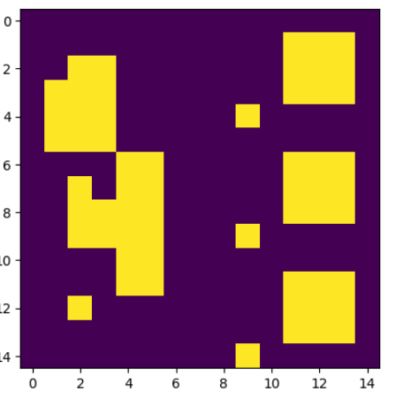
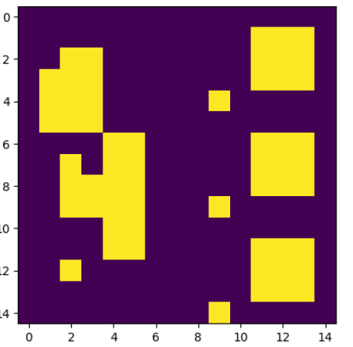
Exo 1:
Image originale
Convolution 1
Filtre 1: c’est l’identité! La convolution produit l’image d’origine

Slide 7
 |  |  |  | 1
 |  |  |  | 1
1
1
1

Slide 8
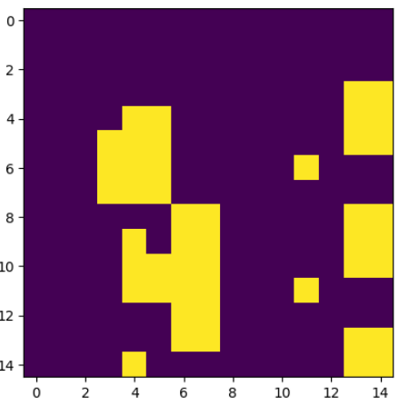
Exo 1:
Image originale
Convolution 2
Filtre 2: La convolution produit une translation de l’image d’origine vers le bas à droite

Slide 9
 | 1 | 1 | 1
 | 1 | 1 | 1
 | 1 | 1 | 1
 |  |  |  | 3
 |  |  |  | 3
 |  |  |  | 4
 |  |  |  | 3
 |  |  |  | 4
 |  |  |  | 5
 | 1 | 1 | 1
 | 1 | 1 | 1
 | 1 | 1 | 1
 | 1 | 1 | 1
 | 1 | 1 | 1
 | 1 | 1 | 1
 | 1 | 1 | 1
 | 1 | 1 | 1
 | 1 | 1 | 1
 | 1 | 1 | 1
 | 1 | 1 | 1
 | 1 | 1 | 1
 | 1 | 1 | 1
 | 1 | 1 | 1
 | 1 | 1 | 1
Symétrie!

Slide 10
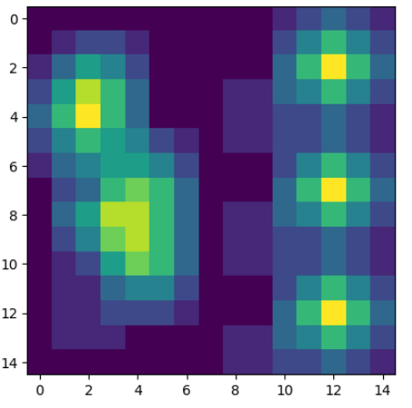
Exo 1:
Image originale
Convolution 3
Filtre 3: La convolution produit une moyenne (des voisins) de l’image d’origine.

Slide 11
 | .5 | .5 | .5
 | .5 | .5 | .5
 | .5 | .5 | .5
 |  |  |  | 1.5
 | .5 | .5 | .5
 | .5 | .5 | .5
 | .5 | .5 | .5
Symétrie!

Slide 12
Exo 1:
Image originale
Convolution 4
Normalisation!
Filtre 4: La convolution produit une moyenne pondérée (la moitié de l’effet du filtre 3) de l’image d’origine.

Slide 13
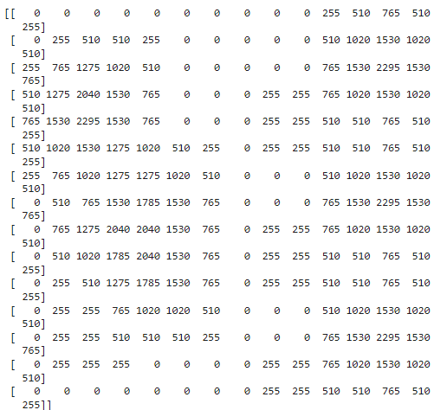
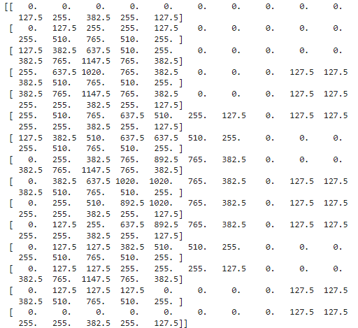
Exo 1:
Jetons un coup de d’œil de plus prés au niveau des pixels à l’aide d’openCV
Convolution 3
Convolution 4
Les valeurs des pixels dans la convolution 4 sont de moitiés par rapport à celles de la convolution 3

Slide 14
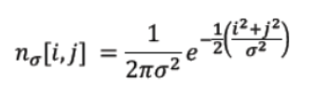





Exo 2:
 | -2 | -1 | 0 | 1 | 2
-2
-1
0
1
2

Slide 15



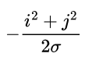


Exo 2:
 | -2 | -1 | 0 | 1 | 2
-2
-1
0
1
2

Slide 16



Exo 2:
 | -2 | -1 | 0 | 1 | 2
-2
-1
0
1
2

Slide 17

Exo 2:
 | -2 | -1 | 0 | 1 | 2
-2 | 0.0029 | 0.0130 | 0.0215 | 0.0130 | 0.0029
-1 | 0.0130 | 0.0585 | 0.0965 | 0.0585 | 0.0130
0 | 0.0215 | 0.0965 | 0.1591 | 0.0965 | 0.0215
1 | 0.0130 | 0.0585 | 0.0965 | 0.0585 | 0.0130
2 | 0.0029 | 0.0130 | 0.0215 | 0.0130 | 0.0029

Slide 18
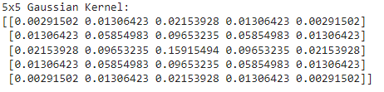
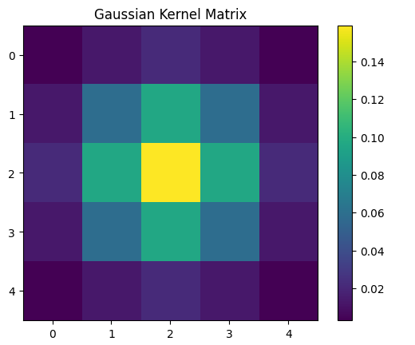
Exo 2:
Avec Python et numpy

Slide 19
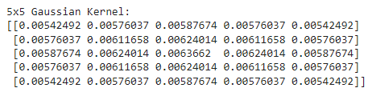
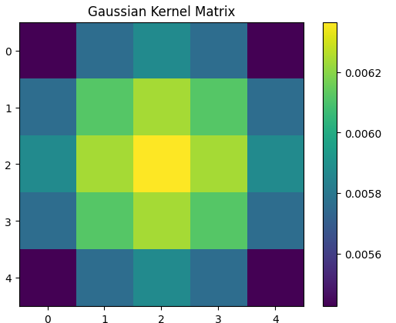
Exo 2:
Avec Python et numpy sigma=5

Slide 20
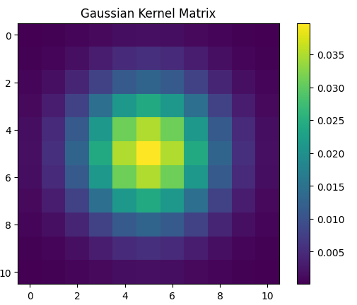
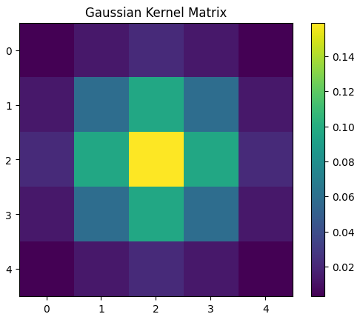
Exo 2:
le paramètre sigma (σ) contrôle l'étalement de la distribution gaussienne.
Augmenter la valeur de sigma dans le filtre gaussien a plusieurs effets :
Augmenter la distribution (étaler)-> un plus grand flou, plus grand perte de détails.
5x5, sigma=1
11x11, sigma=2

Slide 21
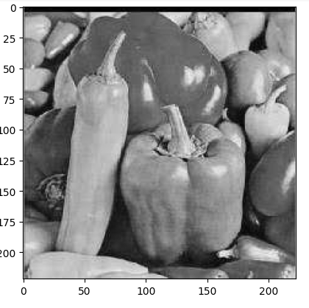
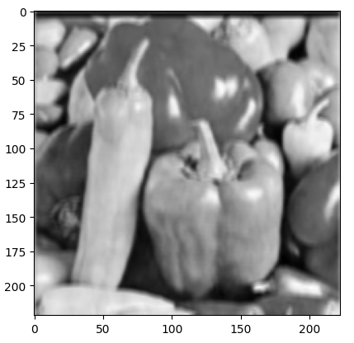
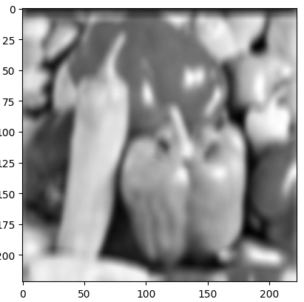
Exo 2:
le paramètre sigma (σ) contrôle l'étalement de la distribution gaussienne.
Augmenter la valeur de sigma dans le filtre gaussien a plusieurs effets :
Augmenter la distribution (étaler)-> un plus grand flou, plus grand perte de détails
Image originale
5x5, sigma=1
11x11, sigma=2

Slide 22
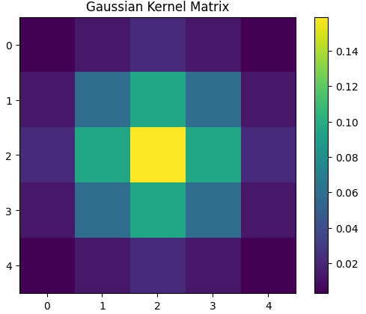
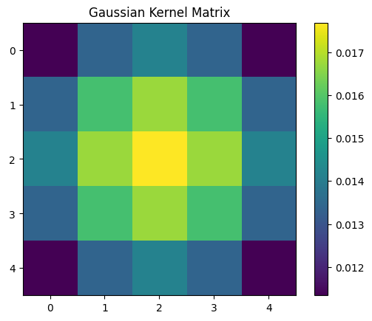
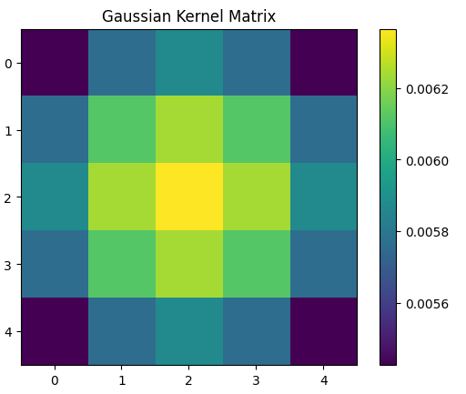
Exo 2:
Augmenter la valeur de sigma dans le filtre gaussien sans augmenter la valeur de K:
5x5, sigma=1
5x5, sigma=3
5x5, sigma=5

Slide 23
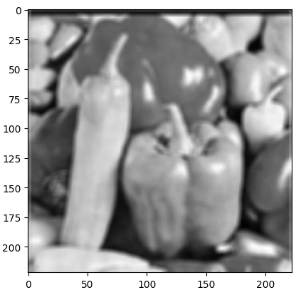
Exo 2:
Augmenter la valeur de sigma dans le filtre gaussien sans augmenter la valeur de K:
Image originale
5x5, sigma=1
5x5, sigma=1

Slide 24
Exo 2:
Filtre gaussien discret:
 | -2 | -1 | 0 | 1 | 2
-2 | 0.0029 | 0.0130 | 0.0215 | 0.0130 | 0.0029
-1 | 0.0130 | 0.0585 | 0.0965 | 0.0585 | 0.0130
0 | 0.0215 | 0.0965 | 0.1591 | 0.0965 | 0.0215
1 | 0.0130 | 0.0585 | 0.0965 | 0.0585 | 0.0130
2 | 0.0029 | 0.0130 | 0.0215 | 0.0130 | 0.0029

Slide 25
Exo 2:
Filtre gaussien discret:
 | -2 | -1 | 0 | 1 | 2
-2 | 0.0028 | 0.0128 | 0.0211 | 0.0128 | 0.0028
-1 | 0.0128 | 0.0574 | 0.0947 | 0.0574 | 0.0128
0 | 0.0211 | 0.0947 | 0.1562 | 0.0947 | 0.0211
1 | 0.0128 | 0.0574 | 0.0947 | 0.0574 | 0.0128
2 | 0.0028 | 0.0128 | 0.0211 | 0.0128 | 0.0028

Slide 26



Exo 2:
Filtre gaussien discret:
Propriété de l’exponentielle:
L’équation précédente devient:
Le filtre gaussien est séparable!

Slide 27






Exo 2:
Filtre gaussien discret:
-2 | -1 | 0 | 1 | 2
4 | 1 | 0 | 1 | 4
-2 | -0.5 | 0 | 0.5 | 2
0.1353 | 0.6065 | 1 | 0.6065 | 0.1353
0.2125 | 0.9527 | 1.5707 | 0.9527 | 0.2125
1 | 4 | 7 | 4 | 1
Normaliser en divisant par le min

Slide 28
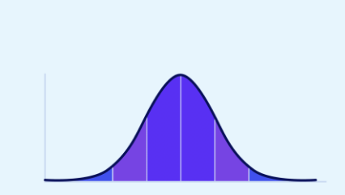
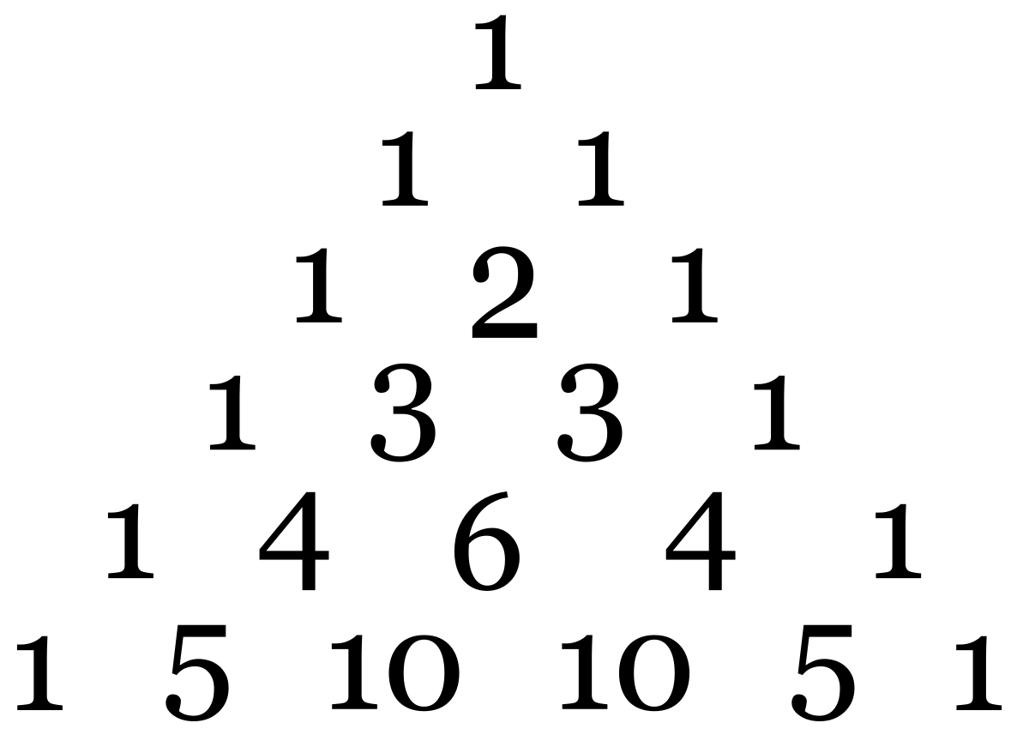
Exo 2:
Filtre gaussien discret:
Fonction Gaussienne 1dimension
Le triangle de pascal
C’est une fonction continue
Approximation discrète d’une fonction gaussienne

Slide 29
Exo 2:
Filtre gaussien discret:
Le triangle de pascal
1 | 4 | 7 | 4 | 1

Slide 30



Exo 2:
Filtre gaussien discret:
Le produit tensoriel
 | 1 | 4 | 6 | 4 | 1
1
4
6
4
1
Somme=256

Slide 31
Exo 2:
Filtre gaussien discret:
Le produit tensoriel
 | 1 | 4 | 7 | 4 | 1
1 | 1 | 4 | 7 | 4 | 1
4 | 4 | 16 | 28 | 16 | 4
7 | 7 | 28 | 49 | 28 | 7
4 | 4 | 16 | 28 | 16 | 4
1 | 1 | 4 | 7 | 4 | 1
Somme=289

Slide 32
Exo 2:
Filtre gaussien discret:
Compromis
 | 1 | 4 | 7 | 4 | 1
1 | 1 | 4 | 7 | 4 | 1
4 | 4 | 16 | 28 | 16 | 4
7 | 7 | 28 | 49 | 28 | 7
4 | 4 | 16 | 28 | 16 | 4
1 | 1 | 4 | 7 | 4 | 1
 | 1 | 4 | 7 | 4 | 1
1 | 1 | 4 | 7 | 4 | 1
4 | 4 | 16 | 26 | 16 | 4
7 | 7 | 26 | 41 | 26 | 7
4 | 4 | 16 | 26 | 16 | 4
1 | 1 | 4 | 7 | 4 | 1
289-256=33
Change=33/2=16

Slide 33
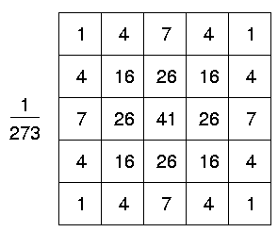
Exo 2:
Filtre gaussien discret:
Le kernel gaussien utilisé dans OpenCV

